Slide 1

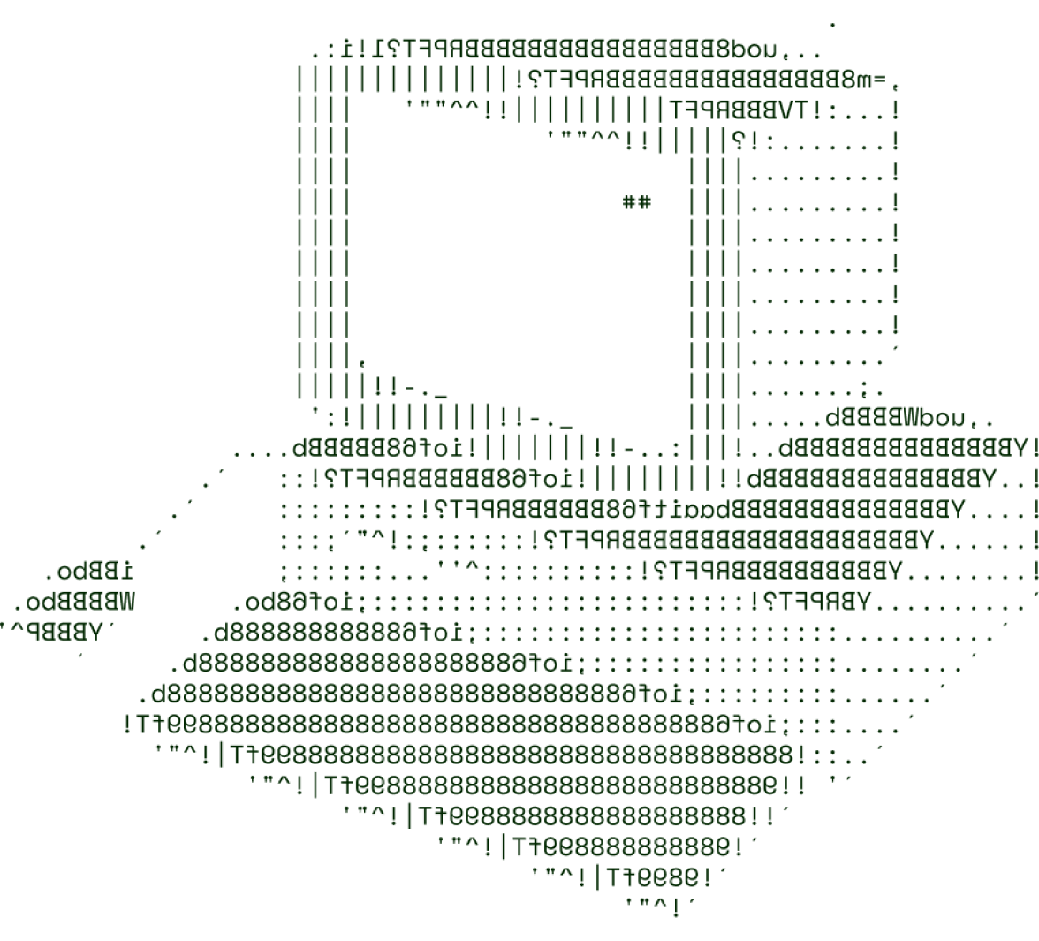

> CRYPTO BASED SUBSCRIPTION
MANAGER
TECH ULTRAS

Slide 2

SOLUTION OVERVIEW
The Crypto Subscription Manager is a platform designed to simplify subscription management by allowing users to manage, automate, and pay for monthly services using cryptocurrency.
Managing subscriptions can be overwhelming, especially when payment methods vary across services. For crypto users, traditional subscription models require converting cryptocurrency to fiat to make payments, leading to additional fees and complexity. This platform eliminates these issues, making the subscription process seamless and efficient.
The Crypto Subscription Manager stands out by bringing cryptocurrency into daily financial management, focusing on real-world applications for crypto beyond investing.

Slide 3
Key Features and Benefits:
Automated Payments: Secure, recurring payments using cryptocurrency for hassle-free subscription management.
Upcoming Renewal Alerts: Customizable notifications ensure users are always aware of upcoming charges, avoiding unexpected overdrafts.
User-Friendly Dashboard: A React-powered interface offers clear and concise tracking of all active subscriptions and their statuses.
Cross-Platform Support: Compatible with popular crypto APIs for easy integration across multiple wallets.

Slide 4
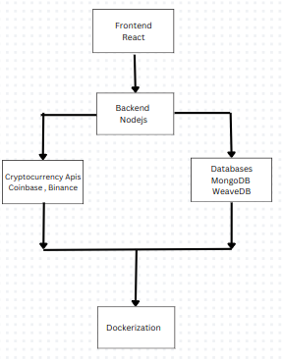
TECHNICAL ARCHITECTURE
Tech stack
Frontend Technologies: React , HTML , CSS , JavaScript , Bootstrap
Backend Technologies: Nodejs , Expressjs , coinbase API , Binance API , mongoose
Database: MongoDB: WeaveDB (Decentralized Database)
Other Tools/Services: Git , Docker , Postman ,
Flowchart:

Slide 5
SCALABILITY AND FUTURE SCOPE
Cloud Services: Hosting on a cloud platform like AWS, Google Cloud, or Azure allows for elastic scalability.
Load Balancing: Implementing a load balancer at the entry point to distribute incoming requests across multiple instances of our services.
Data Management: Utilizing a NoSQL database for subscription details and a relational database for transactions ensures that high-volume data can be stored and accessed efficiently.
Enhanced Security Measures: Integrating two-factor authentication (2FA) and end-to-end encryption for secure transactions and data privacy.
Multi-Currency Support: Adding support for multiple cryptocurrencies, letting users manage and pay for subscriptions in their preferred currency.

Slide 6
FEASIBILITY
Regulatory Compliance:
Challenge: Cryptocurrency regulations vary significantly across countries, posing potential legal risks and compliance challenges
Strategy: Design the platform to be adaptable for compliance with KYC/AML policies by integrating third-party verification services and closely monitoring regulatory updates in key regions.
Transaction Fees and Processing Times:
Challenge: High transaction fees and processing delays, particularly for popular networks like Bitcoin and Ethereum, could hinder user experience and affordability.
Strategy: Incorporate layer-2 solutions to reduce fees and improve transaction speeds. Allowing users to select lower-fee coins like Solana for payments could provide additional flexibility.

Slide 7

>Team Details

Slide 8




Joseph Remingston L
Shubhrajyoti Ghose Biswas
23BCE8134
Team Leader
23BCE7261
Team member
Tarun Kumar
Soumil Sengupta
23BCE7563
Team member
23BCE8800
Team Member

Slide 9

Thanks for Joining

